Slide 1
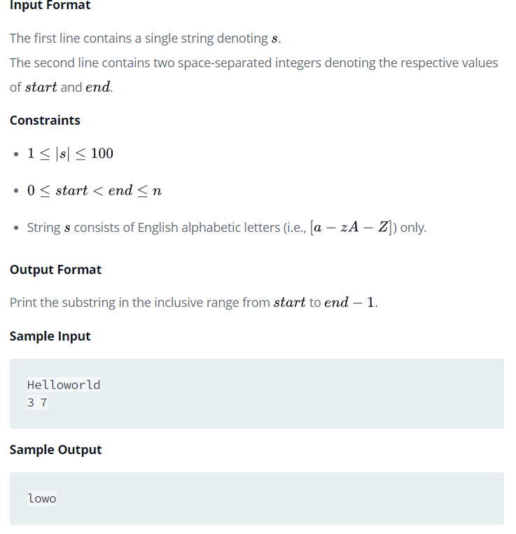
Problem- Java SubString from HackerRank-

Slide 2
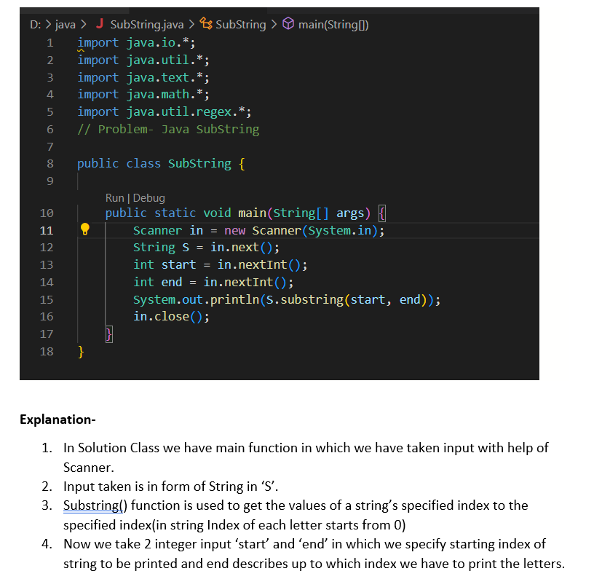
Solution- Java Substring with Explanation

Slide 3
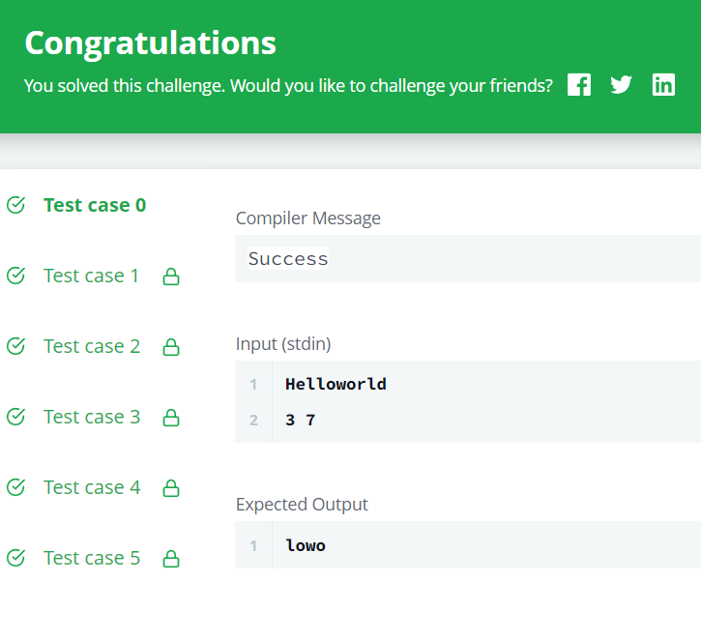
Output-

